Slide 1
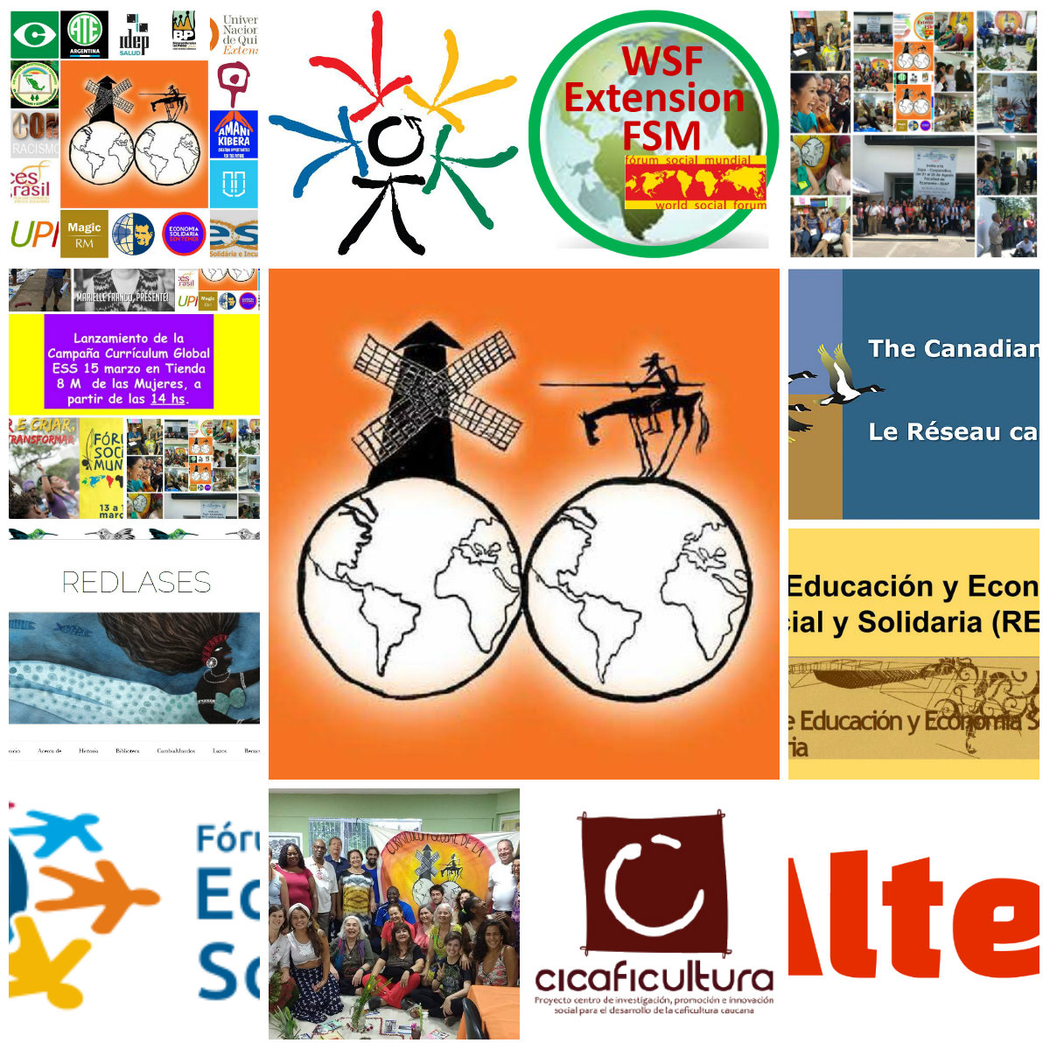
Campaign for a Global Curriculum of Social Solidarity Economy
It is an initiative of networks, social organizations, social movements, universities, schools and other institutions, which seek to join, at a global level, the counterhegemonic educational struggle in face of the capitalist economic system.

Slide 2

What are the objectives
Articulate a pedagogy of the ‘other economies’ which exists in the five continents and is embedded in curricula, didactic proposals, knowledge, epistemologies, methodologies, sciences, learning-teaching and practices of formal, nonformal and informal education; it is developed in schools, universities, social movements, cooperatives, unions, associations, indigenous, Afro-descendant, peasant communities in the construction of a fair, sustainable, non-capitalist economy.
Foster dialogue among the most diverse kinds of knowledge, circulating in territories of urban and rural areas - scientific, humanistic, popular, traditional- ; rescuing the basic principles of popular education and historical educational experiences from the social solidarity economy movement; also strengthening the global citizenship’s movement of transition for a planetary civilization, based on the values of “Good Living”(Bien Vivir), solidarity and respect for Mother Nature (Pachamama)

Slide 3
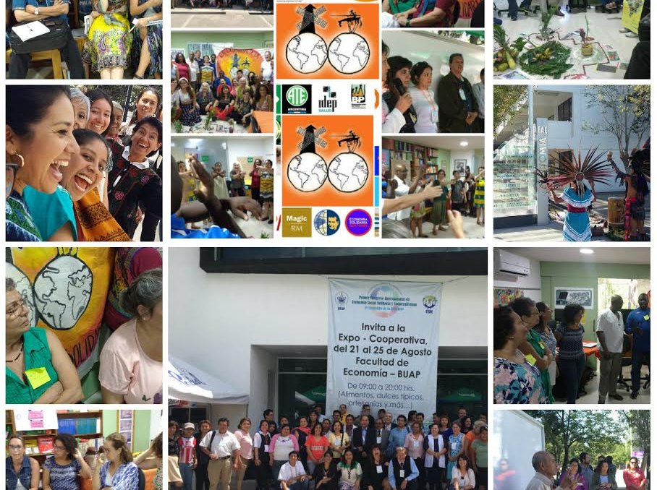
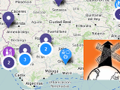
What the Campaign does...
➔ Face-to-face Meetings
2017- March: Rio , Brasil (CECIP)
August: Puebla- Mexico (BUAP)
2018- May: Barcelona-Spain (EduAlter) May: Bogotá- Colombia (Univ. Coop. Colombia) December: Nairobi- Kenya (Amani Kibera)
2019 2019: Barcelona World Social Forum of Transformative Economies, Argentina 8th Forum Towards Another Economy, Belgrade Education for global citizenship; recalibrating the actions of global civil society
➔An Interactive Map with Socioeco.org where we can all upload pedagogical
http://curriculumglobaleconomiasolidaria.com/enviar-herramientas/
actions in the framework of the confluence of the World Social Forum of the Transformative Economies to be held in Barcelona 2020

Slide 4
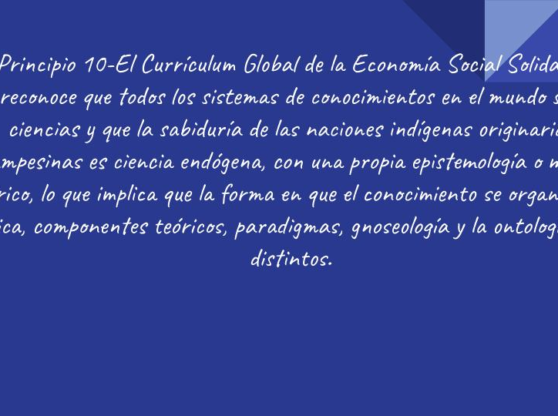

What the campaign does …
➔Webinar Meetings with the coordinating team , to make collective decisions on initiatives and proposals
➔Charter of Principles in 4 languages – it has 17 principles so far; and those principles are put into consideration in the meetings http://curriculumglobaleconomiasolidaria.com/espanol/carta-de-principios/

Slide 5
Who can participate? How?
Who?
All of us. Groups that perform transformative educational actions, representing real praxis
http://curriculumglobaleconomiasolidaria.com/espanol/convite-a-participar/
How?
- Participating in the Working Commissions/ Teams
- Uploading material to the Interactive Map
- Organizing face-to-face meetings
- Spreading the initiative
- Producing material to communicate the Campaign

Slide 6
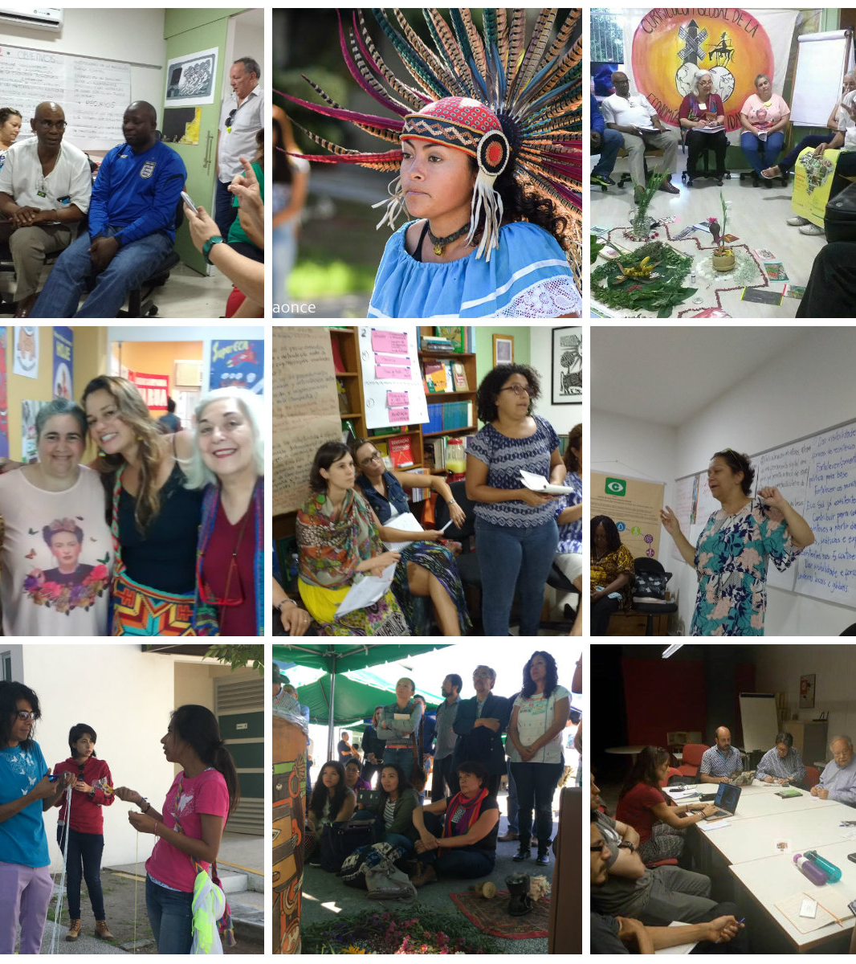
Working Commissions
➢Communication Team
➢Financial Funding Team
➢Charter of Principles Team
➢Systematization Team
➢Mobilization Team

Slide 7
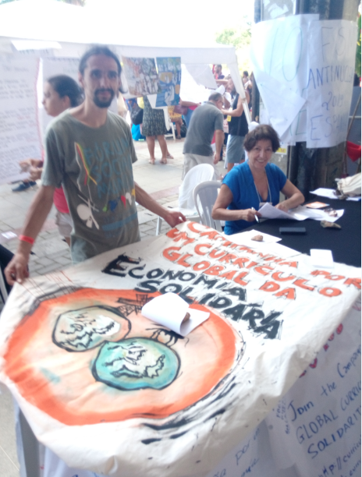
Join the Campaign: http://curriculumglobaleconomiasolidaria.com/contacto/
Email: curriculumglobaleconomiasocial@gmail.com
Facebook: Http://facebook.com/curriculumglobalecosocial
Site: Http://curriculumglobaleconomiasolidaria.com

